Slide 1
Statistics and Reliability: Module 3
Graphics
Notes:
Module Topics
Statistical Rules of Thumb
Common graphical statistical methods: Box-and-whisker plots, Run charts, Scatter diagrams, Pareto charts, Histograms, Normal probability plots
Multi-vari studies
Copyright (c) Deere & Company, as an unpublished work. This material is the property of Deere & Company. All use, disclosure, and/or reproduction not specifically authorized by Deere & Company is prohibited.

Slide 2

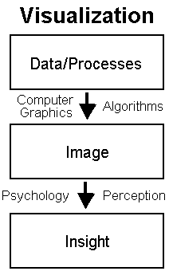
“You can observe a lot by watching”
Notes:
[http://www.yogi-berra.com/yogiisms.html]
Before we go any further, we should look at the data.
Simply “plugging and chugging” can be very dangerous.
If the the normal distribution doesn’t fit the data well, then the statistics we calculate (mean and standard deviation), and the estimates we derive from them, are useless (i.e. WRONG).

Slide 3
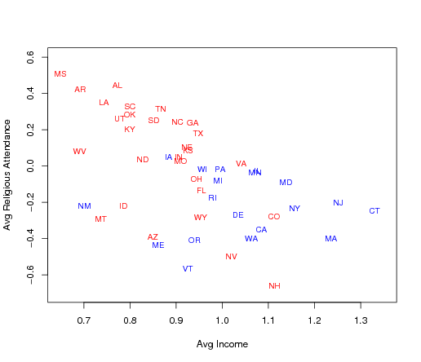
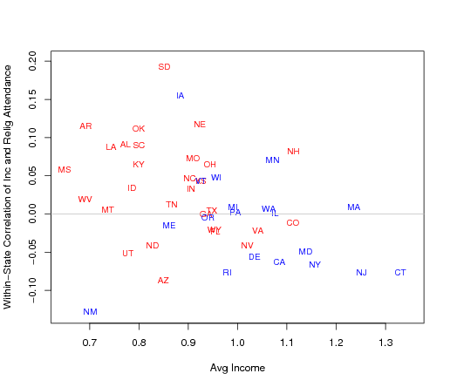
Notes:
http://www.stat.columbia.edu/~cook/movabletype/archives/2007/01/income_religiou.html
To get more understanding of the patterns of income and religion by state, here's state average religious attendance vs. state average income, with the colors indicating states that went for Bush or Gore in 2000:
There's a negative correlation, but also regional patterns, with the western states (except for Utah), some northeastern states, and some others below the main line.
And here are the within-state correlations between income and religious attendance (again plotted vs. state average income):
Religious attendance is positively correlated with income in Mississippi (for example) but negatively correlated in Connecticut. Thus, the zero correlation between income and Republican voting in Connecticut ("What's the matter with Connecticut") is partly explained by the fact that poor people in Connecticut are more religious than rich people in Connecticut. (But this doesn't tell the whole story, as we can see from the graphs at the top of this entry.)

Slide 4
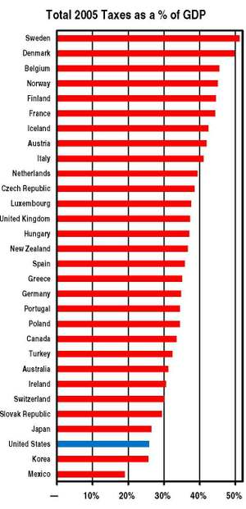
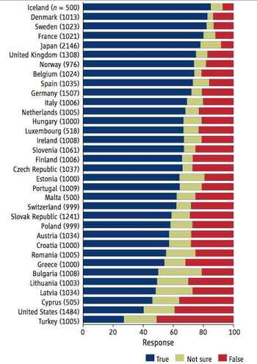
Notes:
LHS: “Evolution Less Accepted in U.S. Than Other Western Countries, Study Finds”
http://news.nationalgeographic.com/news/2006/08/060810-evolution.html
People in the United States are much less likely to accept Darwin's idea that humans and apes share a common ancestor than adults in other Western nations, a number of surveys show. A new study of those surveys suggests that the main reason for this lies in a unique confluence of religion, politics, and the public understanding of biological science in the United States. Researchers compared the results of past surveys of attitudes toward evolution taken in the U.S. since 1985 and similar surveys in Japan and 32 European countries. In the U.S., only 14 percent of adults thought that evolution was "definitely true," while about a third firmly rejected the idea. In European countries, including Denmark, Sweden, and France, more than 80 percent of adults surveyed said they accepted the concept of evolution. The proportion of western European adults who believed the theory "absolutely false" ranged from 7 percent in Great Britain to 15 percent in the Netherlands. The only country included in the study where adults were more likely than Americans to reject evolution was Turkey.
RHS: “U.S. Remains One of Least Taxed Industrial Countries”
http://taxprof.typepad.com/taxprof_blog/2007/04/ctj_releases_us.html
Taxes continue to take up a relatively small part of American economic output, according to data compiled by Citizens for Tax Justice from the Organization for Economic Cooperation and Development, the U.S. Treasury and the U.S. Census. For example, in all but two OECD countries, taxes make up a larger percentage of gross domestic product (GDP) than in the United States.
“That may be one reason Americans work harder.” (http://gregmankiw.blogspot.com/)

Slide 5
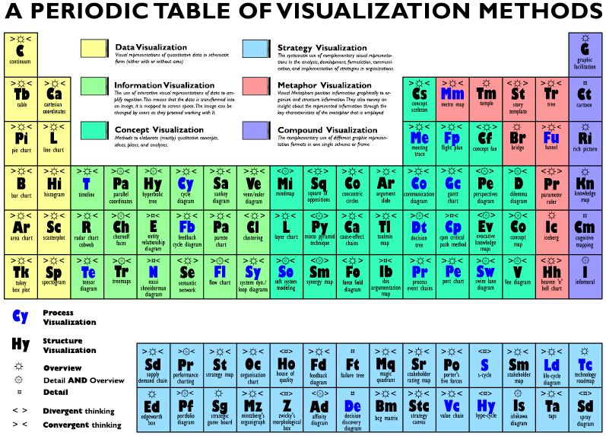
Notes:
http://www.visual-literacy.org/periodic_table/periodic_table.html
As you can see from this chart, there are many approaches to visualization. We will only focus on the basic statistical ones, which are classified as “Data Visualization” on this chart.

Slide 6
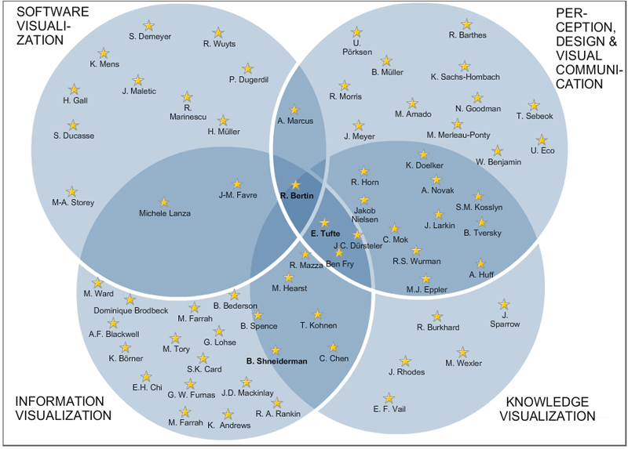
Notes:
http://www.elab.usilu.net/usi10anni/knowledge_domain_maps/visualization_scholars/
I highly recommend you study Tufte, who is in the middle of this chart. His books are works of art in themselves:
The Visual Display of Quantitative Information
Envisioning Information
Visual Explanations
Beautiful Evidence
Available at: http://www.edwardtufte.com/tufte/

Slide 7
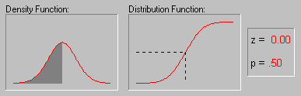
Shape of the Distribution, Normality
Notes:
An important aspect of the "description" of a variable is the shape of its distribution, which tells you the frequency of values from different ranges of the variable. Typically, a researcher is interested in how well the distribution can be approximated by the normal distribution (see the animation below for an example of this distribution). Simple descriptive statistics can provide some information relevant to this issue. For example, if the skewness (which measures the deviation of the distribution from symmetry) is clearly different from 0, then that distribution is asymmetrical, while normal distributions are perfectly symmetrical. If the kurtosis (which measures "peakedness" of the distribution) is clearly different from 0, then the distribution is either flatter or more peaked than normal; the kurtosis of the normal distribution is 0.

Slide 8
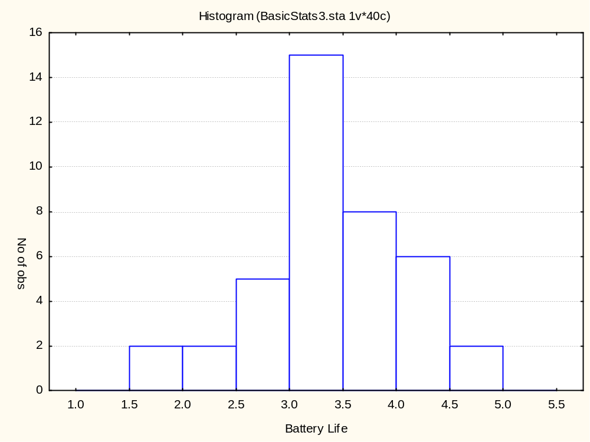
Notes:
What: A bar graph display of the distribution of measurement data of a product or process
Why: Determine the shape of a distribution
Whether the “spread” of the data falls within specifications, and, if not, how much falls outside
Whether the data is centered at the right place - are there too many items on the “high” or “low” side?
When:
Need to identify the distribution in order to apply the proper statistical tools
Need to show process capability graphically
How:
Count the number of data points in the data set
Determine the range R for the entire data set
Divide the range value into a certain number of classes, referred to as K
Determine the class width (R/K)
Determine the class boundary or end points
Construct a frequency table based on the values computed above
Construct a bar graph based on the frequency table

Slide 9
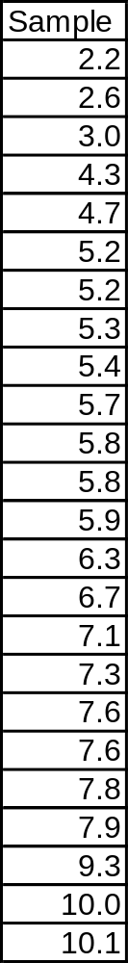
Example 3.2: Histogram and Dot Plot
Notes:
Page 81: “A sample yields the following 24 data points, ranked low to high value.”
First you need to format the data from 2 rows to a single column.

Slide 10
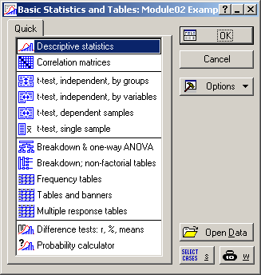
Notes:
First try:
Statistics > Basic Statistics/Tables > Descriptive statistics > OK

Slide 11
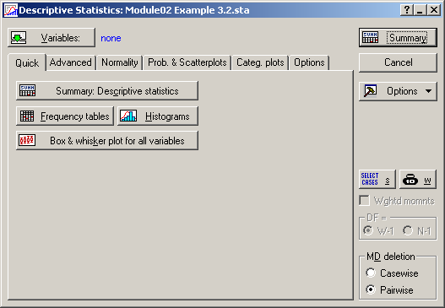
Notes:
Descriptive Statistics
Click the “Variables:” button and select the variable, i.e. Sample, and then select “Histograms” on the “Quick” tab.

Slide 12
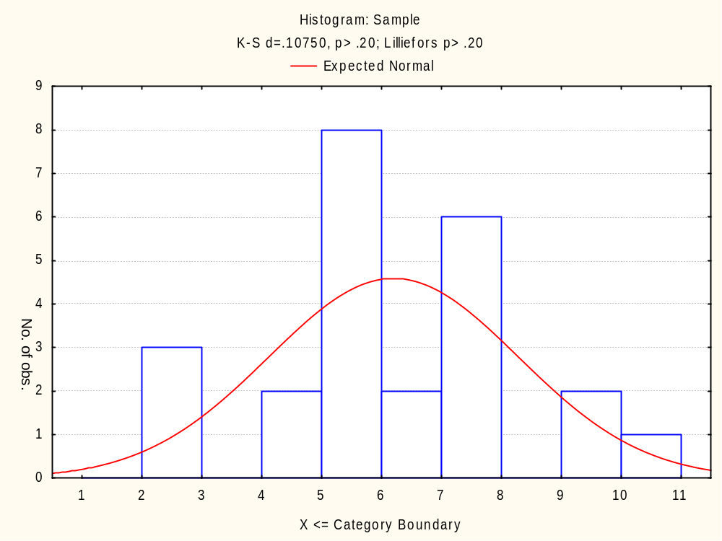
Notes:
Compare to FIGURE 3.5 Histogram of the data. Both have 7 bars, but they look different because they have different interval boundaries.
Also, the Basic Statistics version put a Normal distribution PDF curve on the histogram, but we have no idea (yet) if the data should be modeled with the Normal distribution. And sometimes by superimposing the Normal PDF on the histogram, people can “see” normality when it doesn’t exist – a psychological optical illusion (there’s a technical term for this, but I forgot it).
We can look at the K-S d statistic or the Lilliefors statistic, but with only 24 values, they are often inconclusive (and beyond the scope of this course).

Slide 13
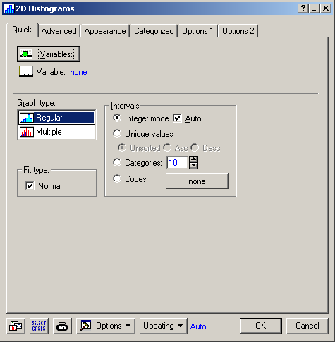
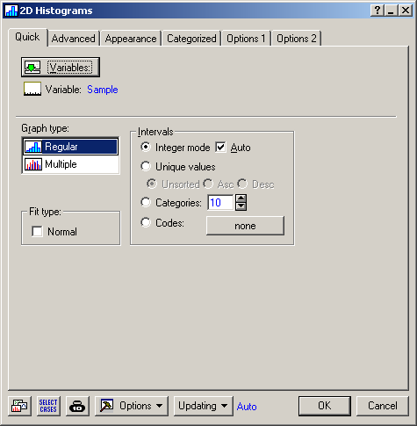
Notes:
Now try:
Graphs > Histograms
Select the “Variables:” button and select the variable, i.e. Sample.
If we leave the default for Fit Type = Normal (LHS), we get the same histogram as before.
Instead, try without the Normal Fit Type (RHS).

Slide 14
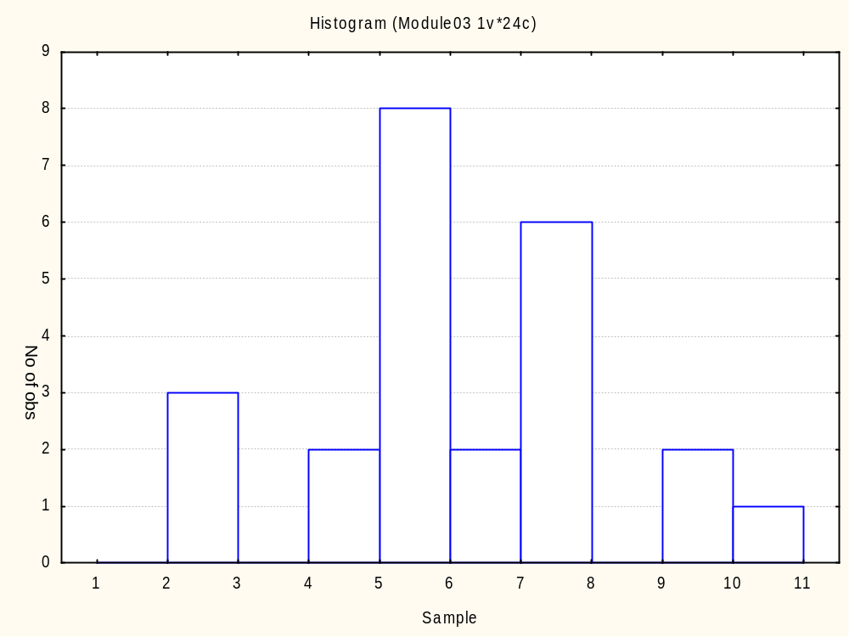
Notes:
Compare to FIGURE 3.5 Histogram of the data.
This looks similar to Slide 8, but there is no Normal distribution PDF curve superimposed and there are no statistical tests for normality reported.

Slide 15
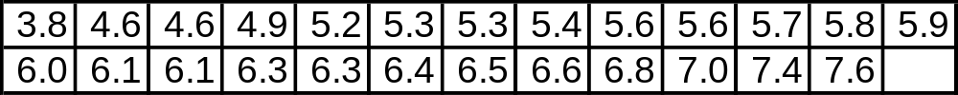
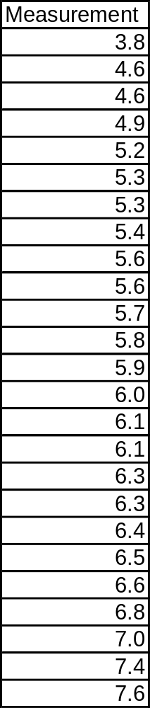
8.4 Example 8.1: PDF, CDF, and the a Probability Plot
Notes:
Page 177: “Consider the following 25 measurements, ranked low to high.”

Slide 16
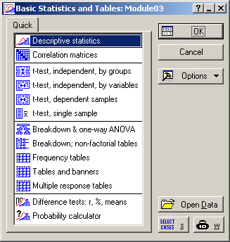
Notes:
Statistics > Basic Statistics/Tables > Descriptive statistics > OK

Slide 17
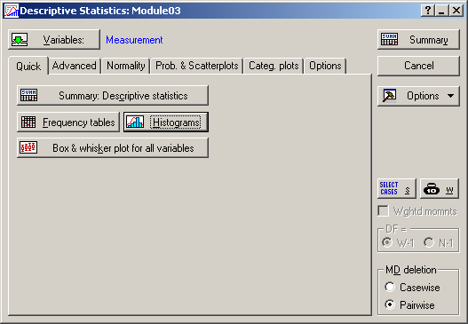
Notes:
Select the “Variables:” button and select the variable, i.e. Measurement. Then select the “Histograms” button.

Slide 18
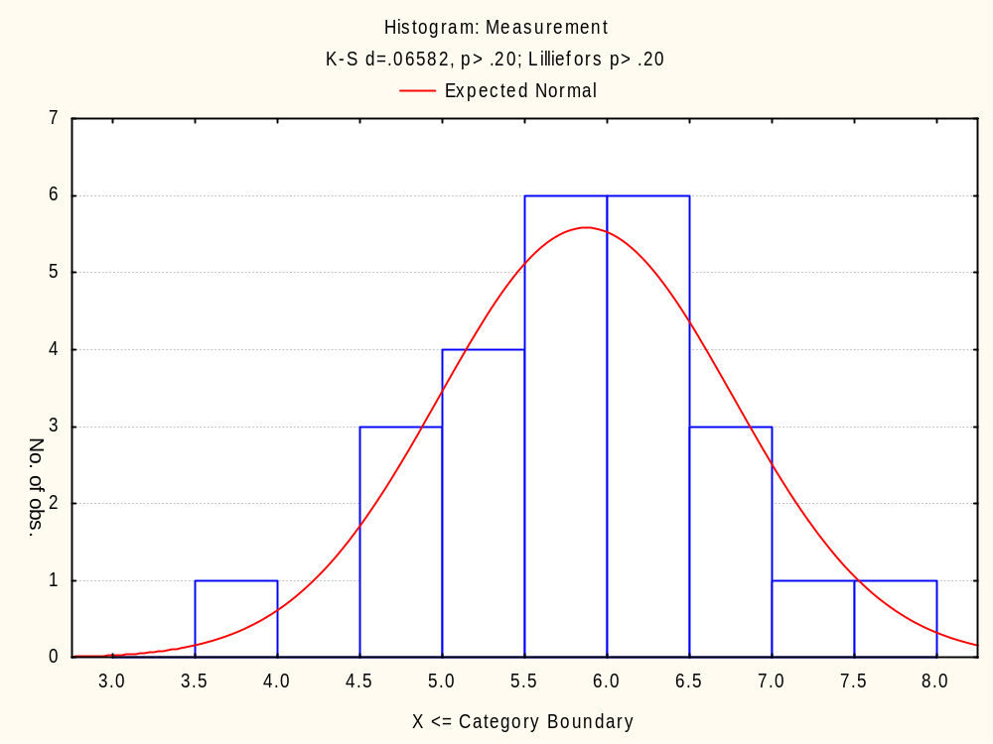
Notes:
Compare to FIGURE 8.1 Frequency distribution and normal PDF.

Slide 19
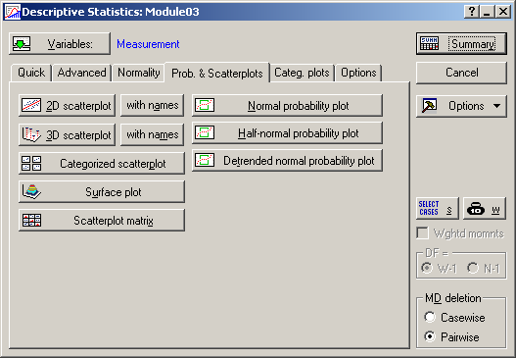
Notes:
Now go to the tab “Prob. & Scatterplots” and select “Normal probability plot”.

Slide 20
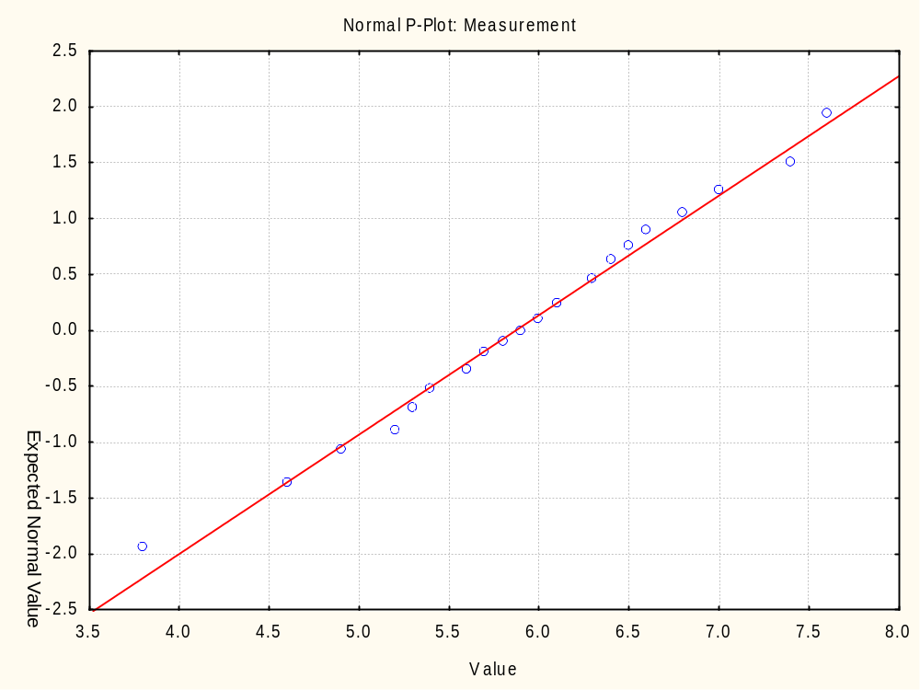
Notes:
Compare to FIGURE 8.3 Normal probability plot.
If the Normal distribution is appropriate, the points should fall along a straight line on a Normal Probability Plot.
Since they do in this case, the Normal distribution is a good choice for this data set.

Slide 21
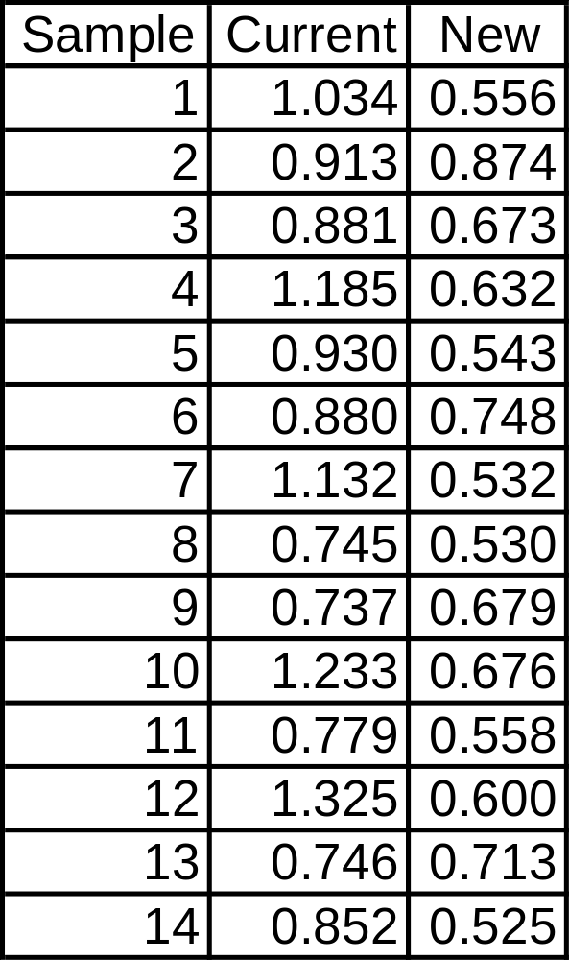
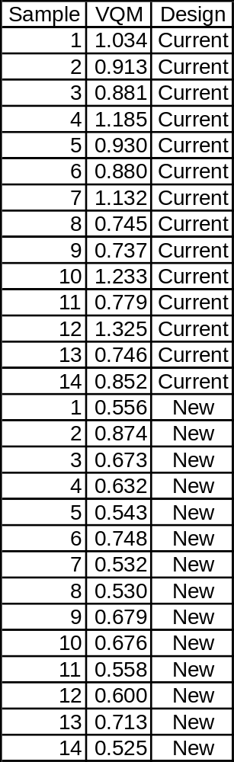
19.5 Example 19.1: Comparing the Means of Two Samples
Notes:
Page 439: “Over 20 changes were considered in multiple DOEs, but only three design changes were found beneficial. A comparison experiment was conducted to confirm and quantify the benefit of these three design changes. The results from the test were as follows (a lower number indicates that a machine has better voice quality).”
VQM = Voice Quality Measure of a portable dictating machine

Slide 22
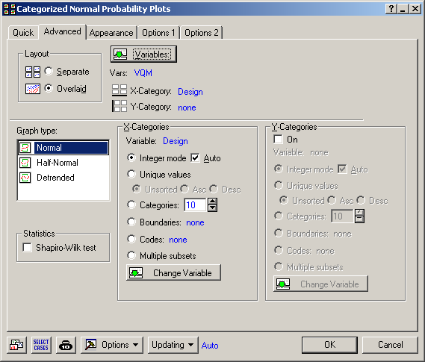
Notes:
Graphs > Categorized Graphs > Normal Probability Plots >
Variables = VQM (Voice Quality Measurement)
X-Category = Design
Overlaid

Slide 23
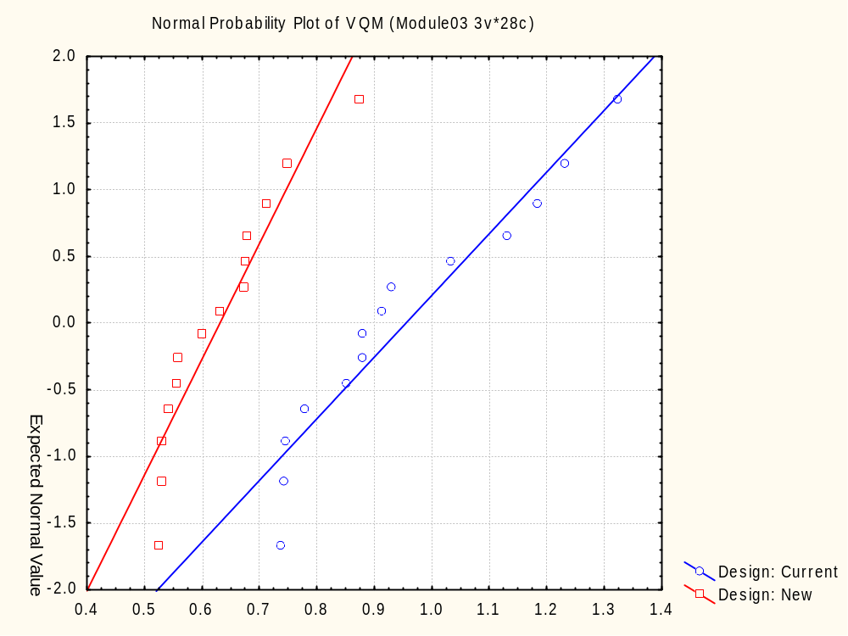
Notes:
Compare to FIGURE 19.1 Normal probability plot comparison.
Both data sets can be modeled with the Normal distribution.
The Current Design has a larger mean (line is farther to the right).
The Current Design has larger variation (smaller slope of the line).

Slide 24
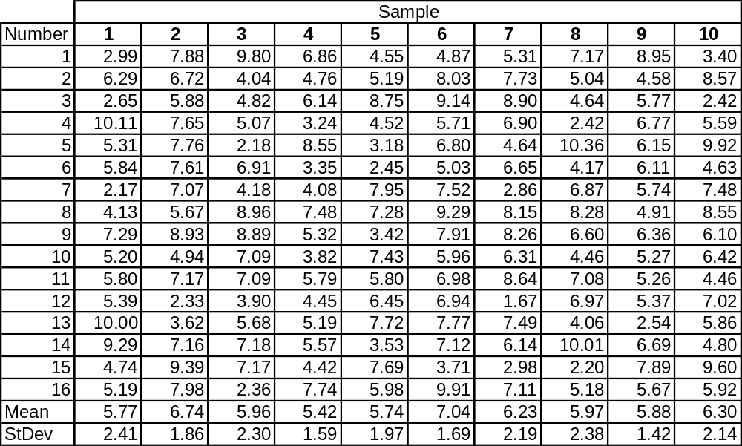
Table 3.3 Ten Random Samplings from a Normal PDF Where μ = 6 and σ = 2
Notes:
We looked at this data set numerically in Module # 2. How let’s look at it graphically.

Slide 25
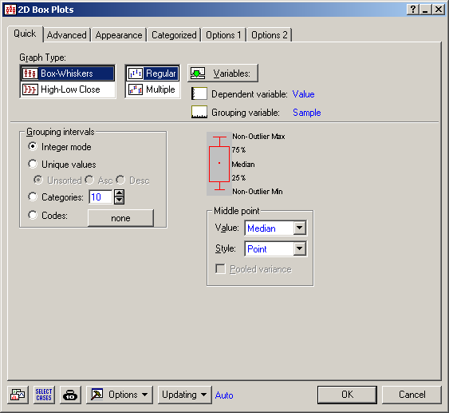
Notes:
Graphs > 2D Graphs > Box Plots
Dependent variable: Value
Grouping variable: Sample

Slide 26
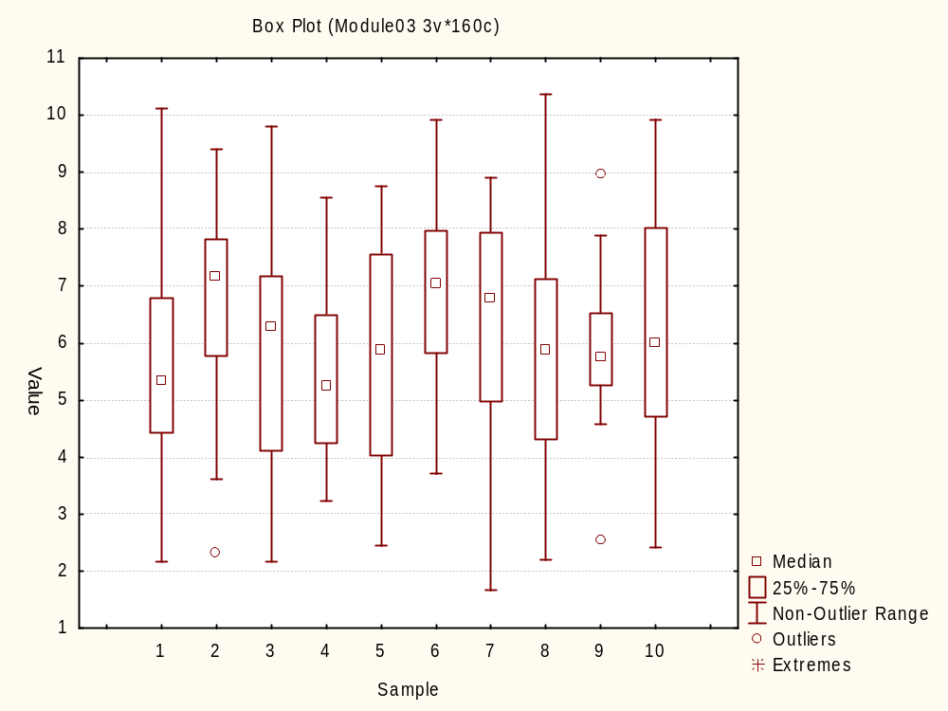
Notes:
Each of the 10 samples were sampled from the same distribution (Normal with mean = 6 and standard deviation = 2), yet they look very different. This is common for small sample sizes (16 in this case).
The main problem of statistics is to find things that are different when there are different or find things that are the same when they are the same when the sample size is small and/or there is variability in the results. When the sample size is very large or there is not much variability, it is easy to make these decisions without statistics.

Slide 27
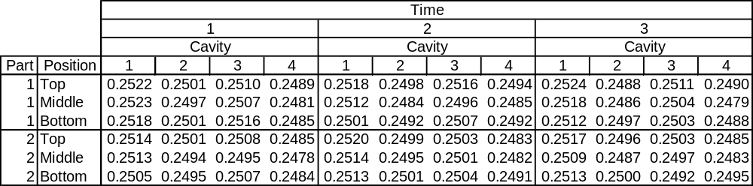
Table 15.1 Multi-vari Chart of Injection-Molding Data
Notes:
Page 388.
An injection-molding process made plastic cylindrical connectors.
Every hour for 3 hours, 2 parts were selected from each of 4 mold cavities.
Measurements were made at each end and the middle.
Create a box plot for Diameter using the Cavity as the grouping variable.
What can you conclude about the 4 different cavities?

Slide 28

Notes:
Graphs > 2D Graphs > Box Plots
Dependent variable: Diameter
Grouping variable: Cavity

Slide 29
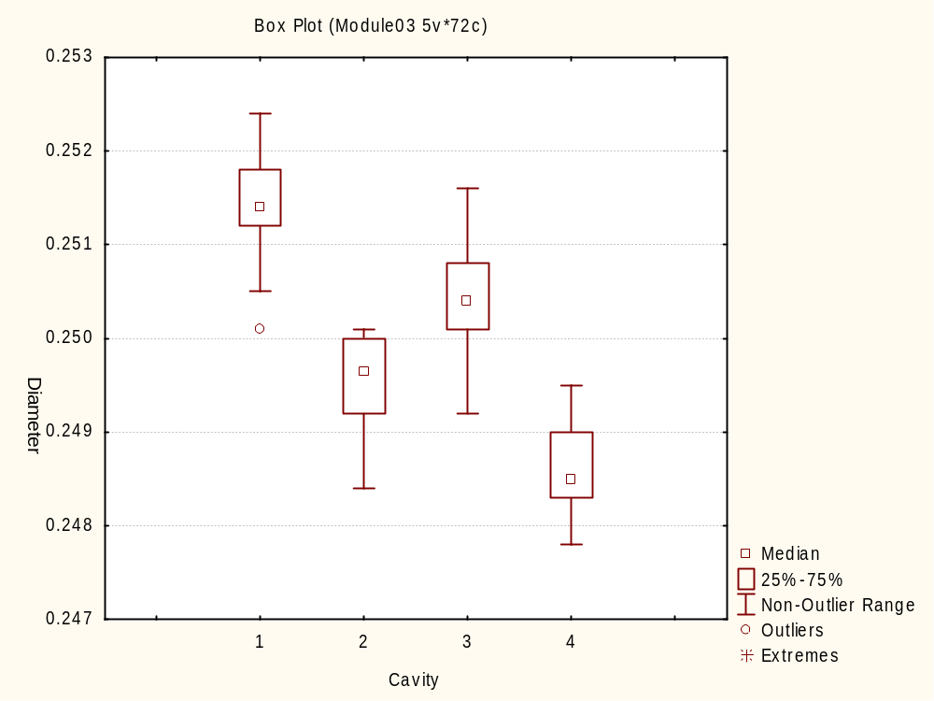
Notes:
Compare to FIGURE 15.3 Box plot of diameter versus cavity.
Looks like all four medians are different: Cavity 1 > Cavity 3 > Cavity 2 > Cavity 4.
And the variation looks about the same.

Slide 30
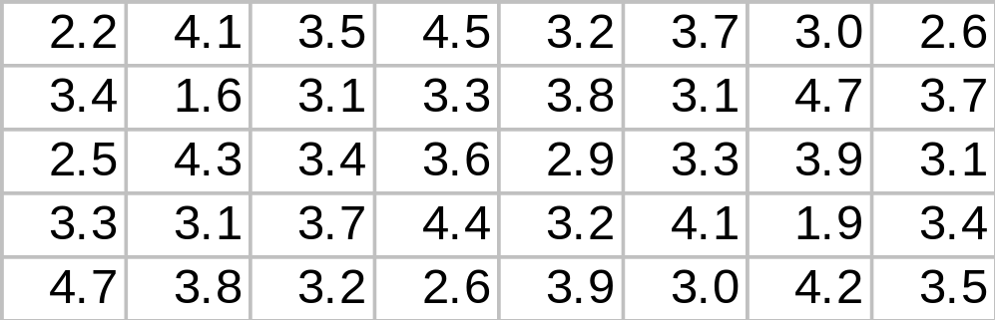
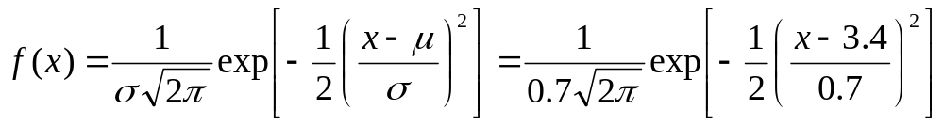
Battery Life Data
Notes:
40 observations of battery lives (years)
Mean μ = 3.4 years
Standard Deviation σ = 0.7 years
Let’s review all three types of plots we covered and get into a little more detail.

Slide 31
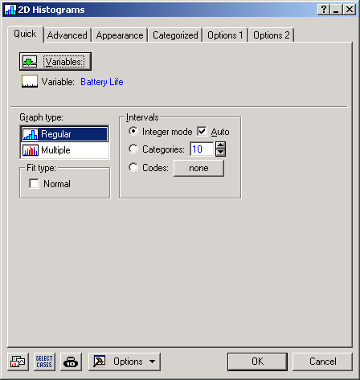
Notes:
Graphs > Histograms (Advanced tab with “Fit type:” equal to “Off”)

Slide 32
Notes:
What: A bar graph display of the distribution of measurement data of a product or process
Why: Determine the shape of a distribution
Whether the “spread” of the data falls within specifications, and, if not, how much falls outside
Whether the data is centered at the right place - are there too many items on the “high” or “low” side?
When:
Need to identify the distribution in order to apply the proper statistical tools
Need to show process capability graphically
How:
Count the number of data points in the data set
Determine the range R for the entire data set
Divide the range value into a certain number of classes, referred to as K
Determine the class width (R/K)
Determine the class boundary or end points
Construct a frequency table based on the values computed above
Construct a bar graph based on the frequency table

Slide 33
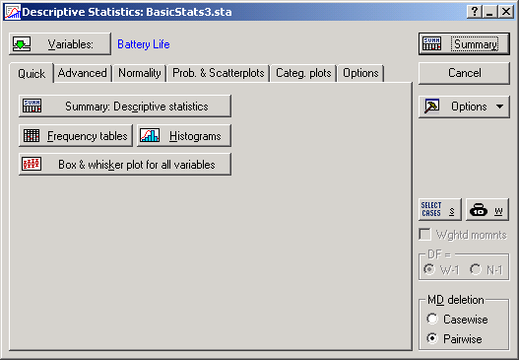
Notes:
Statistics > Descriptive Statistics – Quick tab > Histograms

Slide 34
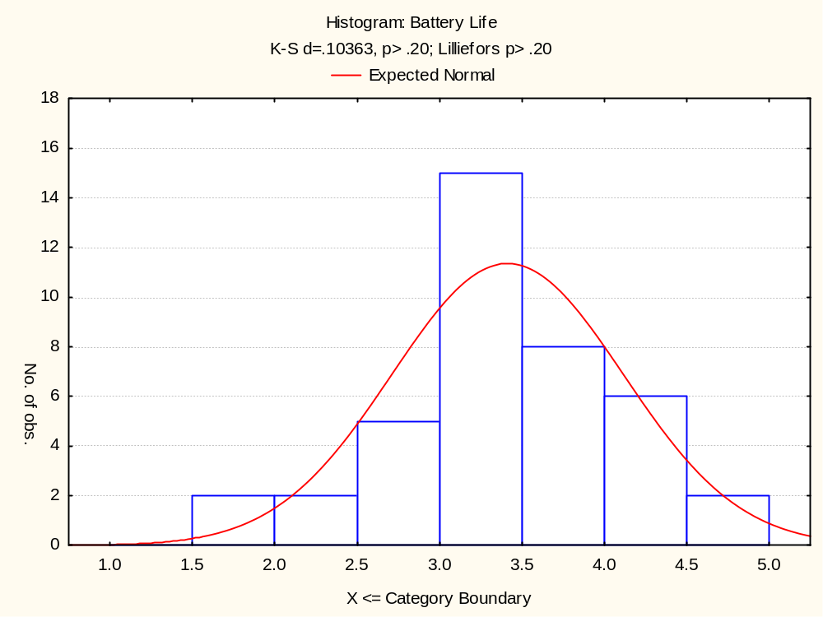
Notes:
Histogram with PDF superimposed.
Can use either:
Statistics > Descriptive Statistics – Quick or Normality tabs
or
Graphs > Histograms – Advanced tab (slightly different appearance)

Slide 35
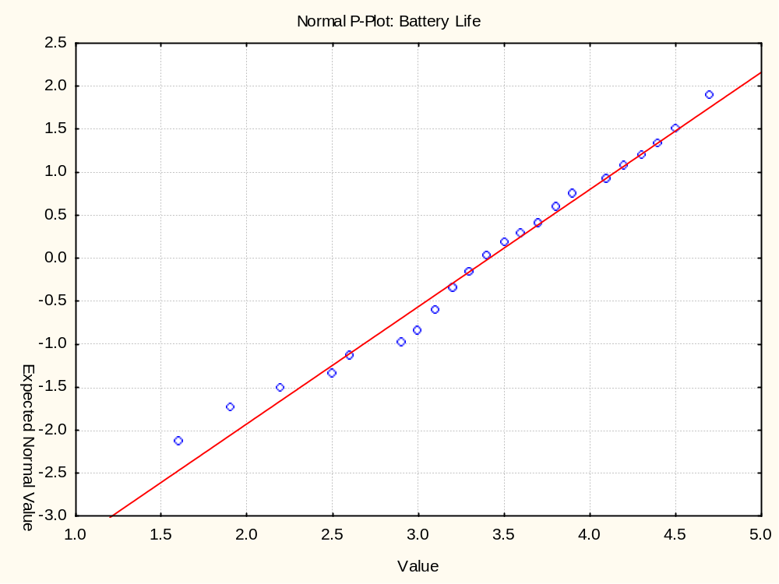
Notes:
What: A 2-dimensional plot of a data set versus its corresponding percentile
Why:
Identify the data’s distribution
Histograms can be misleading, especially if sample size is small
Estimate the distribution’s parameters
When:
Need to identify the distribution in order to apply the proper statistical tools
Need to assess fit of a distribution
Need to check model assumptions
How:
Sort data from lowest (1) to highest (n) and assign numbers i = 1…n
Calculate Percentile: p(i)

Slide 36
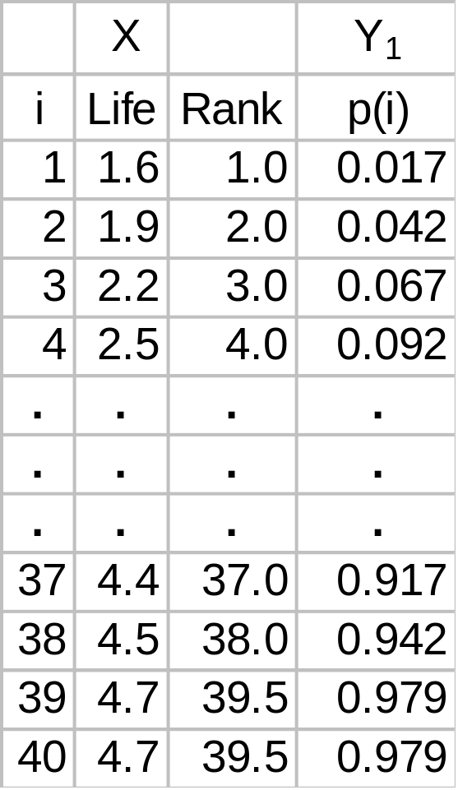
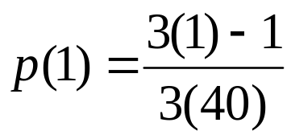
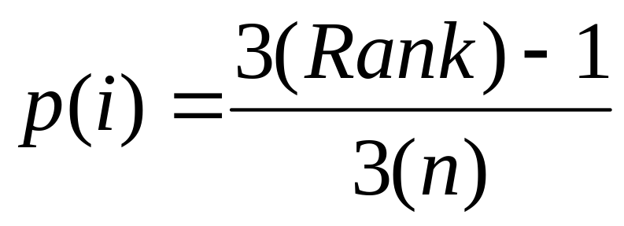
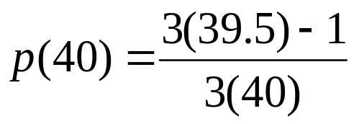
Battery Life Data Percentiles
Notes:
Statisica has 4 methods to determine ranks.
This is important when there are ties in the data set.
For the Normal Probability Plot, the “mean” ranking method is used, i.e., take the mean of the order (i) of the tied data.
Then Statistica uses the empirical percentile formula:
p(i) = [3(Rank) – 1]/[3(n)]

Slide 37
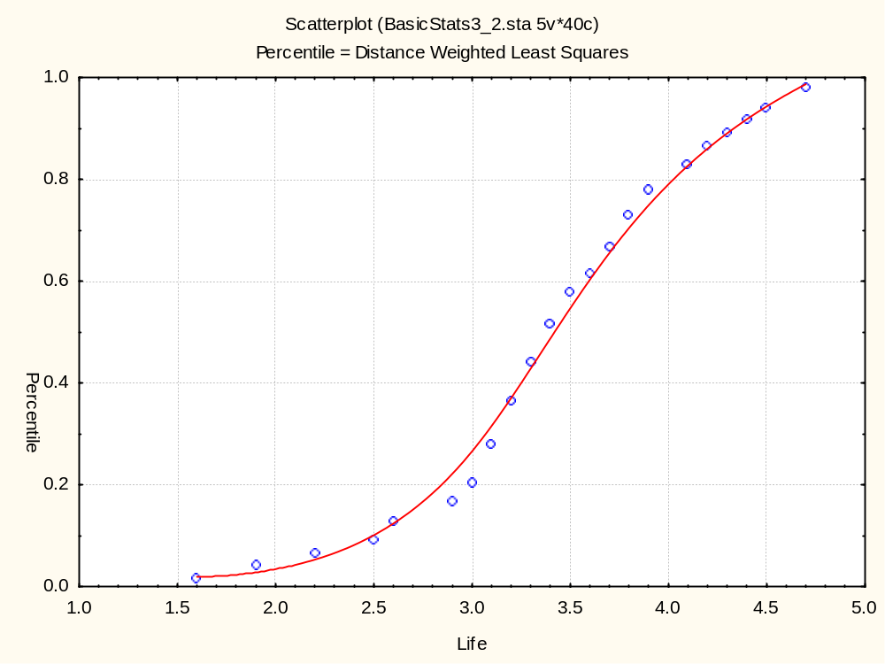
Notes:
If we plotted X (Life) versus Y₁ (Percentile), we get a “S” shaped curve like the one above. We want to “linearize” this with a transformation.

Slide 38
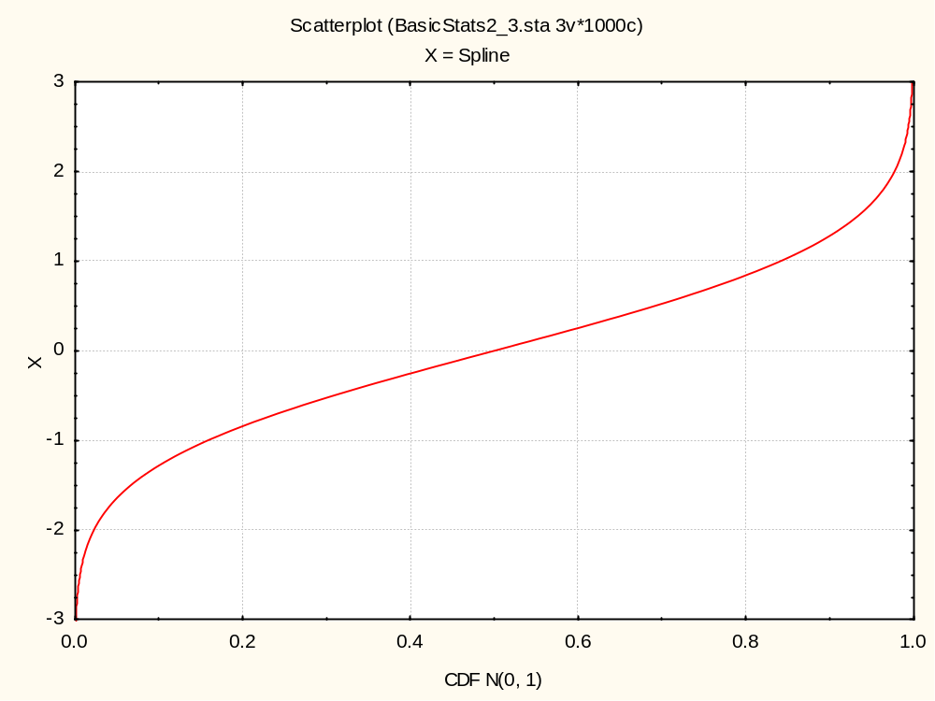
Notes:
Inverse Normal CDF plot: N⁻¹(p)
Normal Probability Plot
How (continued):
Transform Percentile using inverse of the Standard Normal Cumulative Distribution Function
Plot data point versus transformed Percentile
If data falls along a straight line, use the normal distribution and estimate parameters
Mean and standard deviation

Slide 39
Standard Normal CDF Notation
Value (x)
N(x)
Probability (p)
INORMAL(x, 0, 1)
Probability (p)
N⁻¹(p)
Value (x)
VNORMAL(p, 0, 1)
Notes:
“Linearize” Y₁ to Y₂ using inverse Normal CDF: N⁻¹[p(i)].
If you want to do this yourself, the name of the Normal CDF function is “INORMAL” for the integral of the Normal distribution, and the inverse of the Normal CDF is “VNORMAL” (I don’t know what the “V” stands for – variable maybe?).

Slide 40
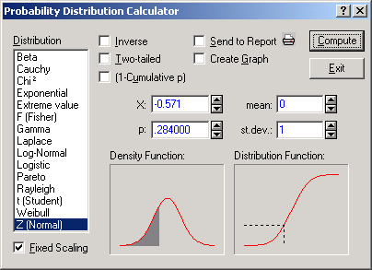
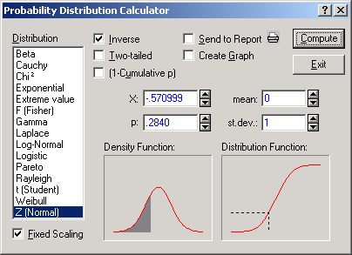
N(x)
N⁻¹(p)
Notes:
Statistica’s Probability Distribution Calculator gives an idea of what’s going on.
If you plug in an “X” value, you get a “p” value, and the inverse box is not checked.
If you plug in a “p” value, you get an “X” value, and the inverse box is checked.
These are important concepts that you will use throughout the rest of the course.

Slide 41
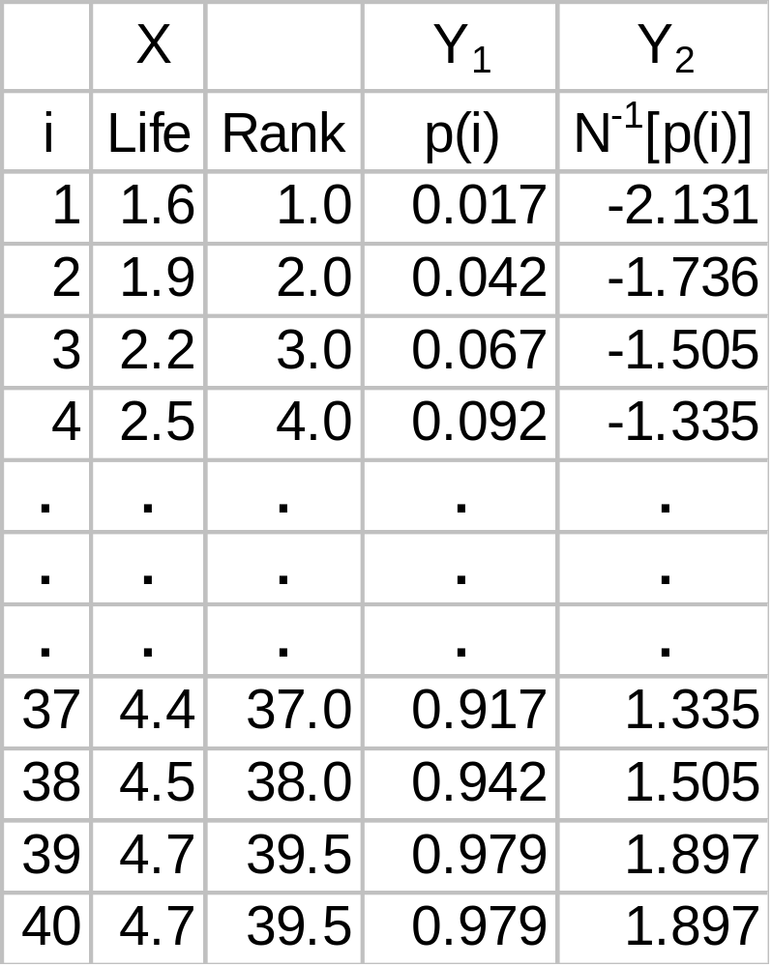
Battery Life Data Transformed Percentiles
Notes:
Apply the inverse Normal CDF to the percentile data, Y₁, to get N-1[p(i)], i.e., Y₂.
Now plot Y₂ versus X.

Slide 42
Mean = 50 %-ile
μ - 1σ = 2.71
μ = 3.41
μ + 1σ = 4.12
Notes:
Points falling along a straight line implies the normal distribution works for this data set.
You can also find the mean and distances from the mean by projecting from the Y-axis to the X-axis.

Slide 43
Notes:
Statistics > Descriptive Statistics – Quick tab > Box & whisker plot for all variables

Slide 44
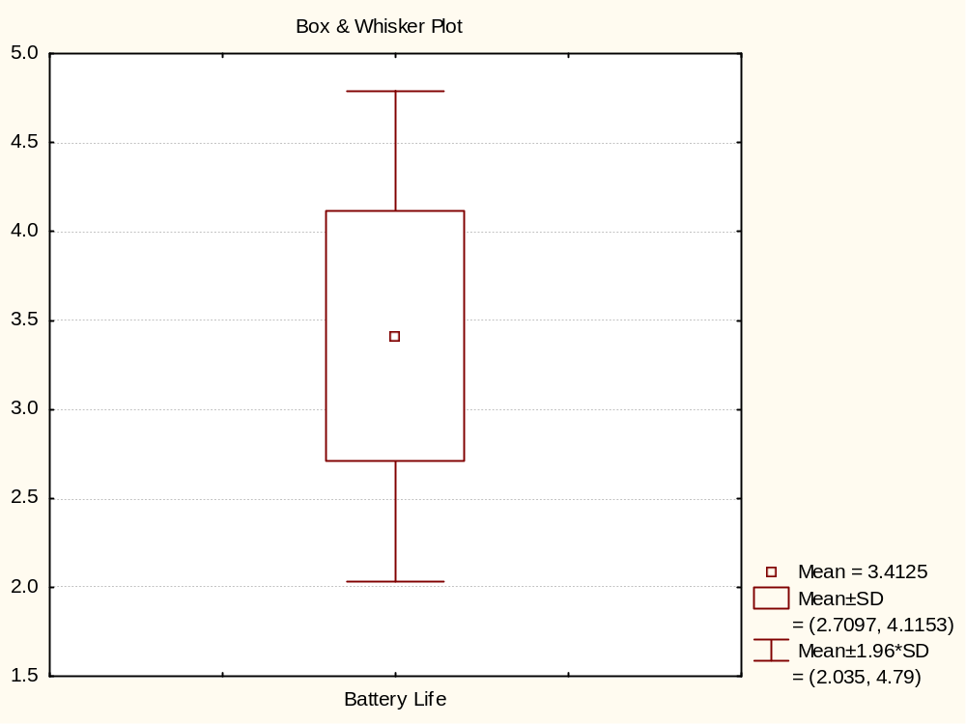
Notes:
This default (?) version gives the:
Mean
Mean +/- 1*(std. dev.) = Top and bottom of box
Mean +/- 1.96*(std. dev.) = Whiskers on box – this is a pseudo confidence interval (sample size and Normality issues?).
There are 3 more versions available in Statistica and many variations are possible.

Slide 45
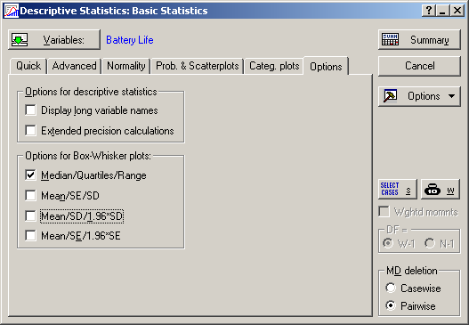
Notes:
The Options tab “Options for Box-Whisker plots” section lets you change the type of box plot.
Try them all and compare.
Also, you could have used:
Graphs > 2D Graphs > Box Plots
to get different versions these and modify them.

Slide 46
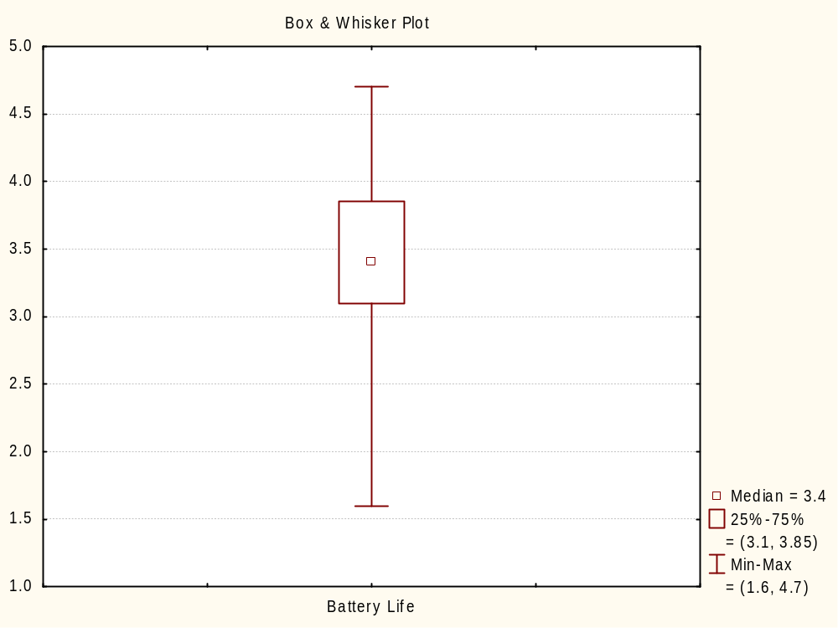
Notes:
The median is 3.4 (50th percentile).
The 25th percentile is 3.1, and the 75th percentile is 3.85.
The Minimum is 1.6, and the Maximum is 4.7.

Slide 47

Notes:
Run Charts (2D Line Plots in Statistica)
What: A visual representation of time series data; a plot of data over time
Why: To monitor a process to see whether or not the long range average is changing
When: You need to do a simple display of observations to determine whether there is a trend over a specified time period
How:
Put measurement being studied on the vertical axis (y-axis) of the graph
Put time metric on the horizontal axis (x-axis) of the graph
Plot data in order that is was gathered
Time sequence of data points is critical
Optional:
Connect data points for easy identification of sequence and interpretation
Draw a straight line across the plot at the average value of the measurements
Run charts are the first step for creating a control chart, which we will cover later (Module 7).

Slide 48

3.4 Example 3.1: Reacting to Data
Notes:
Data from page 76.
The product has specification limits of 72-78.

Slide 49

Notes:
Graphs > 2D Graphs > Line Plots (Variables)
Select the “Graphs” menu.
Select the “2D Graphs” option.
Select the “Line Plots (Variables)” sub-option.
Select “Variables” and then enter “Response”.
Click “OK”.
Note the Case Names are the Measurement number; otherwise Statistica will print “Case 1”, “Case 2”, “Case 3”, etc. on the X-axis (which is rather annoying). To do this, select the “Cases” button on the data view, select “Case Names Manager...”, and enter “Measurement” in the “Transfer case names” variable field.

Slide 50

Notes:
Compare to FIGURE 3.2 Reacting to common-cause data as though it were special cause.
Since the product has specification limits of 72-78, these lines were manually superimposed on the plot – but do not ever confuse them with control limits!

Slide 51

Notes:
Use a scatter plot to describe relationship between two “interval” or “ratio” variables (instead of cross-tabulations for frequency data of “nominal” or “ordinal” variables).
What: Plot of one variable versus another variable whereby the horizontal axis (x-axis) represents the measurement values of the first variable and the vertical axis (y-axis) represents the measurements of the second variable.
Why: To study the possible relationship between two variables.
When: You need to display what happens to one variable when another variable changes in order to test a theory that the two variables are related.
Example: DiscountA (discounts adjusted for inflation) and Warr2A (Period 2 -- 7-12 months -- warranty adjusted for inflation)
[Note: scale was adjusted so that minimum Warr2A is 0 and minimum DiscountA is 0 to avoid showing impossible regions.]

Slide 52


Scatter Plot Examples
First set of experimental data
Not Randomized
Second set of experimental data
Randomized
Notes:
3.14 Example 3.4: Experimentation Trap – Lack of Randomization

Slide 53

Notes:
Graphs > Scatterplots
Select
X = Duration1
Y = Strength1
Select Polynomial on the Advanced tab.

Slide 54

Notes:
Compare to FIGURE 3.8 Plot of the first set of experimental data.

Slide 55

Notes:
Now select
X = Duration2
Y = Strength2
Select Linear on the Advanced tab.

Slide 56

Notes:
Compare to FIGURE 3.9 Plot of the second set of experimental data.

Slide 57


Reformat Data
Notes:
Define:
Test = 1 for Test1 data
= 2 for Test2 data
And store the duration data in a single column called Duration and the strength data in a single column called Strength.

Slide 58

Notes:
Graphs > Categorized Graphs > Scatterplots
X = Duration
Y = Strength
X-Category = Test
Overlaid
Fit type = Linear

Slide 59

Notes:
This plot clearly shows that if we failed to randomize (Test = 1), we would conclude that increasing the Duration increases the Strength. But if we randomize (Test = 2), we would conclude there is no relationship between Duration and Strength.
Maybe there is a residual effect, for example, pressure in the system from the previous experiment?

Slide 60
19.5 Example 19.1: Comparing the Means of Two Samples
Notes:
Let’s return to Example 19.1 (page 439), which compared 2 designs: Current versus New.
VQM = Voice Quality Measure of a portable dictating machine

Slide 61

Notes:
Graphs > Categorized Graphs > Scatterplots
X = Sample
Y = VQM
X-Category = Design
Overlaid
Fit type = Off

Slide 62

Notes:
For every sample (1 – 14), the blue dots are above the red dots, therefore the New design has lower VQM than the Current design. And as indicated on page 439, “a lower number indicates that a machine has better voice quality.”

Slide 63

  ☹
  ☺
Electronics
Work on these
Ignore these (for now)
Notes:
Pareto Charts
What: A special form of a bar graph which helps us determine which problems to solve in what order.
Why: Helps us direct our attention and efforts to the truly important problems; we will generally gain more by working on the tallest bar than tackling the smaller bars.
When: You need to display the relative importance of all of the problems or conditions in order to choose the staring point for problem solving, monitor success, or identify the basic cause of a problem.
The top 6 items have approximately 80% of the cost. So those are the ones that should be worked on first, and the others should be ignored for the time being. Note, however, that this is not a absolute rule. For example, the 6th item, Solenoids/Actuators, has 3.58% of the cost while the 7th item, Alternators, has 3.53% of the cost. There is very little difference between them, so it’s at the users’ discretion whether to work on the top 5, 6 or 7 times. The key is not to spend time on the items below these, i.e. items 8 through 18, because, no matter how effective the improvements are, they will have negligible effect on the bottom line.

Slide 64


Pareto Chart Example
Notes:
From “5.20 Example 5.1: Improving a Process that has Defects” on page 131.

Slide 65

Notes:
Statistics > Industrial Statistics & Six Sigma > Quality Control Charts > Pareto chart analysis (Quick or Variables tabs)
Select the “Statistics” menu.
Select the “Industrial Statistics & Six Sigma” option.
Select the “Quality Control Charts” sub-option.
Select “Pareto chart analysis” on the “Quick” tab or the “Variables” tab.

Slide 66

Notes:
Choose the 3rd option: “Codes and counts” and then select the variables.
Typically -- but not always -- select “Codes and counts” – if you have one variable with defect type and one variable with the counts of the defects.
Then select the “Variables” button to specify which variable contains the defect types and which variable contains the counts.

Slide 67

Notes:
Var. with defect types (codes) = Defect
Variable with defect counts = Count

Slide 68

Notes:
The default view.

Slide 69

Notes:
I prefer showing the labels on the y-axis (easier to read) and showing the % of each column.
Select “Reverse axes in chart” and “Show % to label columns” and then click the “Pareto chart” button to show the revised chart.
You should play around with this menu to see the different views.

Slide 70

Notes:
Obviously you should work on Insufficient solder first (55% of the defects).
Then Blow holes (15% of the defects – Cumulative is 70%).
And then Unwetted (10% of the defects – Cumulative is 80%).
Don’t waste resources on the other defect types at this time, no matter how easy they might be – there are minimal gains to be made.

Slide 71

Notes:
Multi-vari Charts
Multi-vari charts are a way of presenting analysis of variance data in a graphical form, and provides a “visual” alternative to analysis of variance.
These charts may also be used in the preliminary stages of data analysis to get a look at the data.
The chart displays the means at each factor level for every factor.

Slide 72
Positional Variation
Position 1
Machine 1
Machine 2
Position 2
Notes:
Positional Variation
Within a single unit or across a single unit with many parts
By position in a batch process
From machine-to-machine or operator-to-operator

Slide 73
Cyclical Variation
Group 1
batch
Group 2
Notes:
Cyclical Variation
Among consecutive pieces
Among groups of pieces
Batch-to-batch or lot-to-lot

Slide 74
Temporal Variation
Time
Notes:
Temporal Variation (Time-to-time)
Shift-to-shift
Hour-to-hour
Day-to-day
Week-to-week

Slide 75

Typical Sampling Plan
* Shift: 5th pcs from each shift
Notes:
Suggestions on Data Collection
Team must follow sampling plan consistently
Note changes that are not part of the normal operation
Capture all the data
Record events that are out of the ordinary
Log all data as soon as possible

Slide 76

13.5 Data Relationship Matrix
Flatness Data Collection Sheet
Notes:
Page 358-359: “A plan might then be created to collect flatness measurements as a function of the key process variables, which would be recorded in the following form.”

Slide 77

Notes:
Graphs > Categorized Graphs > Scatterplots
X = Pressure
Y = Flatness
X-Category = Shift
Overlaid
Linear Fit (Advanced tab)

Slide 78

Notes:
This is just one of many ways of looking at the data.
This seems to imply that Flatness decreases as Pressure increases, and there may be Shift differences, especially for Shift 2 (this typically happens when the ambient temperature of the factory changes during the day).
But with only 6 data points, I would caution against making any inference about the nature of the process – this is just meant to illustrate a graphical approach to problem solving.

Slide 79
Table 15.1 Multi-vari Chart of Injection-Molding Data
Notes:
Page 388.
An injection-molding process made plastic cylindrical connectors.
Every hour for 3 hours, 2 parts were selected from each of 4 mold cavities.
Measurements were made at each end and the middle.
Create a multi-vari chart for this data.
What can you conclude?

Slide 80

Notes:
Go to Graphs > Categorized Graphs > Scatterplots
Select:
X = Time
Y = Diameter
X-Category = Position
Y-Category = Cavity
Separate
Fit type = Linear

Slide 81

Notes:
There might be a Time effect: sometimes the Diameter values increase as time goes from 1 to 2 to 3, sometimes they decrease, and sometimes they stay the same (flat line).
There seems to be Cavity effect: Cavity 1 (top row) has much higher values than Cavity 4 (bottom row).
It’s hard to tell if there is a Position effect – several of the plots change as you go from left to middle to right, but it’s not consistent.
Let’s try some other types of plots.

Slide 82

Notes:
Go to Graphs > Categorized Graphs > Box Plots
Select:
Dependent variable = Diameter
Grouping variable = Position
X-Category = Cavity

Slide 83

Notes:
Now we can see the Cavity and Position effects more clearly.
Except for Cavity 1, the Middle Position has lower Diameter than the Top or Bottom Positions. But for Cavity 1, Top > Middle > Bottom. Statisticians call the dependency of the Diameter response on combinations of Cavity and Position an “interaction.”
For Cavity, Cavity 1 has the highest values and Cavity 4 has the lowest values.

Slide 84

Notes:
Go to Graphs > Categorized Graphs > Scatterplots
Select:
X = Cavity
Y = Diameter
X-Category = Position
Overlaid
Fit type = Lowess

Slide 85

Notes:
Compare to FIGURE 15.6 Interaction plot of cavity and position.
Cavity 1 > Cavity 3 > Cavity 2 > Cavity 4 – Why? Why? Why? Why? Why? (That’s 5 Why’s for those that are counting.)

Slide 86


But wait, there’s more... We are just scratching the surface
Notes:
EDA: Exploratory Data Analysis (e.g., box plots, stem-and-leaf diagrams, probability plots).
Often just exploring the data can be fruitful, e.g. identify typos, repeat values, unlikely or suspicious values, insightful values.
(Check http://www.itl.nist.gov/div898/handbook/eda/eda.htm)
Ggobi (http://www.ggobi.org/): an advanced EDA tool that’s gaining popularity (because it’s free?).
Some things to think about:
What kind of data do you have -- nominal, ordinal, interval or ratio?
Have you tried Pareto Charts while Problem Solving, e.g. 8D and 5 Whys?
Can you put the data on a geographical map?

